Slide 1


Hadith Series
40 Ahadith Compilation

Slide 2
Introduction to the book
The Author & the Book • Author: ‘Ali ibn Sultan Muhammad, also known as Mulla ‘Ali al-Qari
• Made hijra to Makkah from Herat • His teacher: Ibn Hajar al-Haytami
Famous works: Mirqat al-Mafatih Sharh Mishkat al-Masabih and many more!
• Passed away in Shawwal of 1014AH, buried in Makkah
• Why forty hadith?
- Many hadith mention the excellence of compiling forty
- Hadith included in Mulla ‘Ali al-Qari’s collection are concise
- Profound meaning in few words
- Easy to memorize/snippets of Hadith
Notes:
This is a note to learn

Slide 3
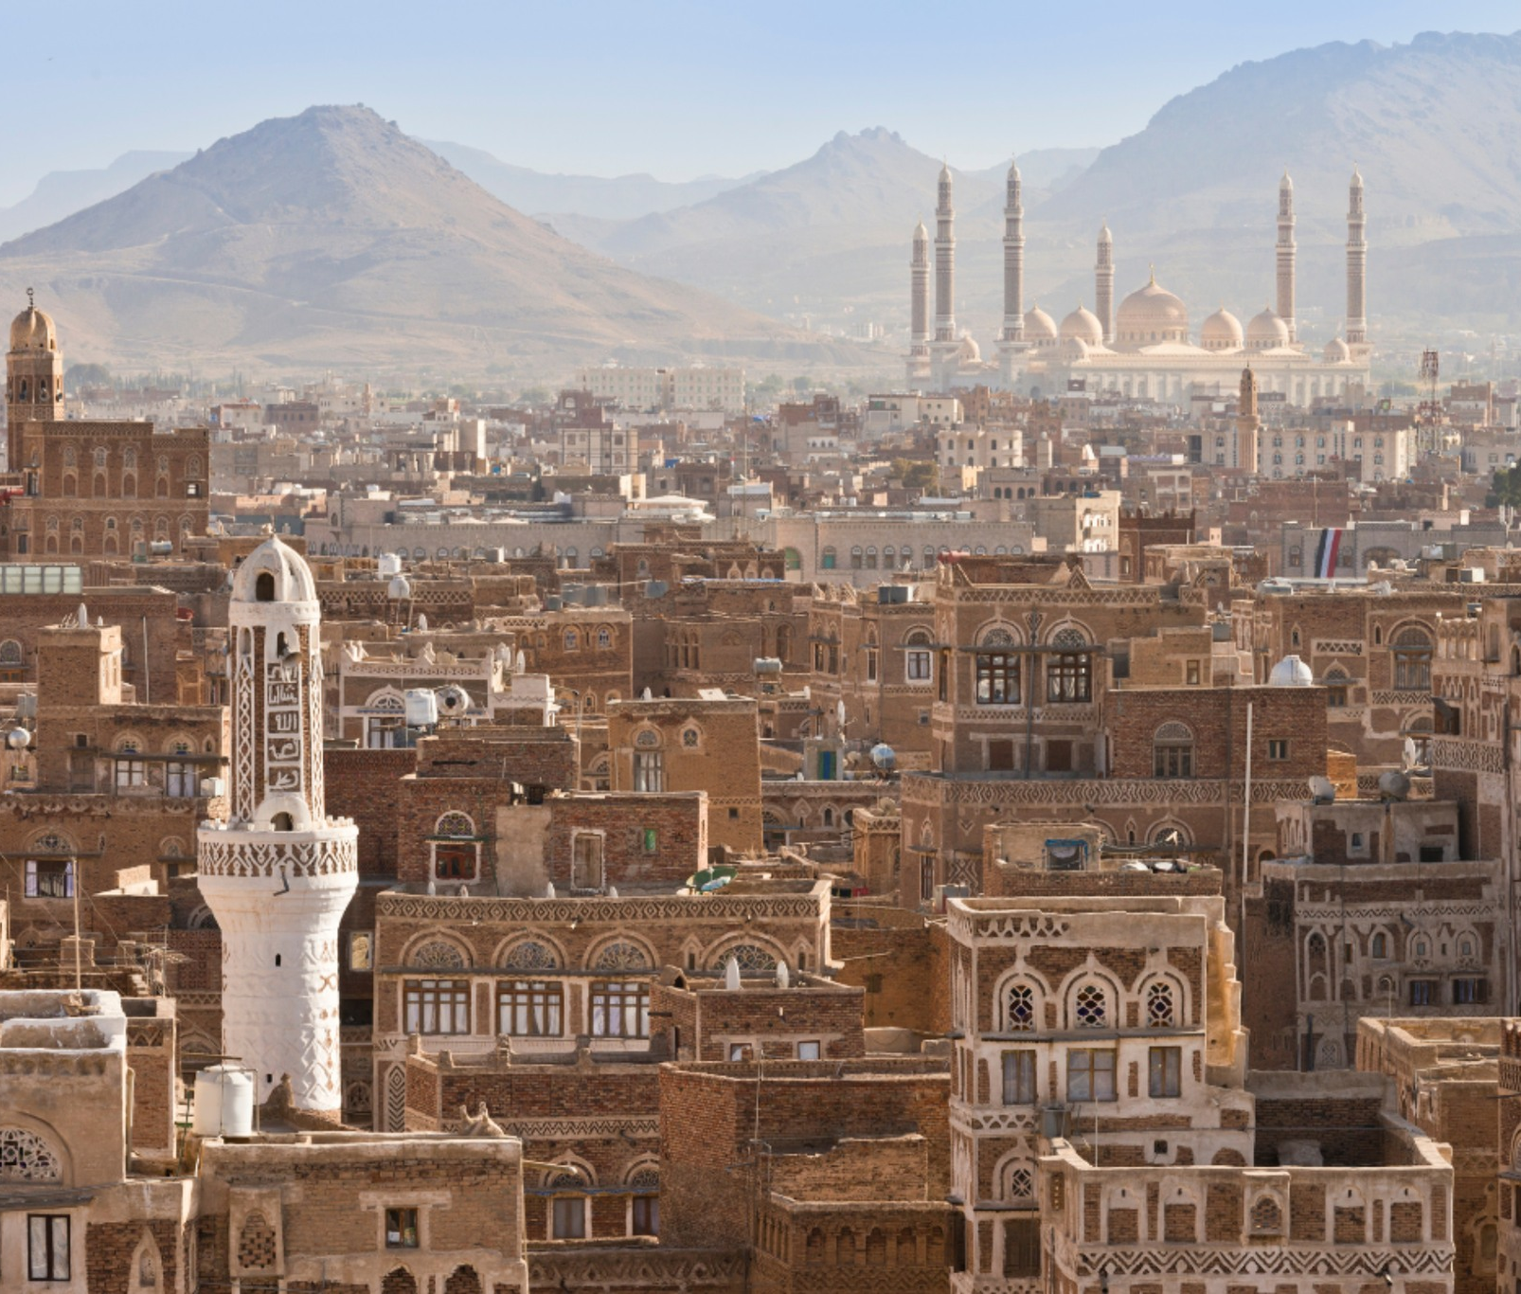
Hadith 1:
“Pride and arrogance are characteristics of the rural Bedouins, while calmness is found amongst the owners of sheep. Faith is Yemeni, and Wisdom is also Yemeni”

Slide 4

Hadith 1: Faith is Yemeni الإِيمَانُ يَمَانٍ
The Prophet's words
The Prophet (saw) said, "Faith (Iman) is Yemeni, understanding (Fiqh) is Yemeni and wisdom (Hikmah) is Yemeni".
The Prophet's actions
The Prophet (saw) also pointed towards Yemen and said, “Faith is there”.
Brief History
Yemen is significant in Islamic history because the Prophet (saw) descended from Yemen (Ancestry) and was sheltered by the descendants of Yemen. The Prophet's tribe, the Quraysh, are descendants of the Banu Jurhum, a pure Arab tribe from Yemen. The Ansar of Madinah, who took in the Prophet and Muhajirun, also have roots in Yemen.

Slide 5

Hadith 1: Faith is Yemeni "‏ الإِيمَانُ يَمَانٍ
Apparent meaning: praise for the people of Yemen! 1st to respond to the call for Hajj. 1st to initiate the shaking of hands.
At that time, Yemenis were receptive of the message and the prophet SAW had high hopes for them
Other interpretations: Makkans/Ansaris
Uways al-Qarni (r) Story: he is coming with Yemeni reinforcements. Mother.
• Takeaway: Consider, what do we want to be known by?

